Slide 1

Rahul Kumar Technical Lead Sigmoid
Real Time data pipeline with Spark Streaming and Cassandra with Mesos

Slide 2

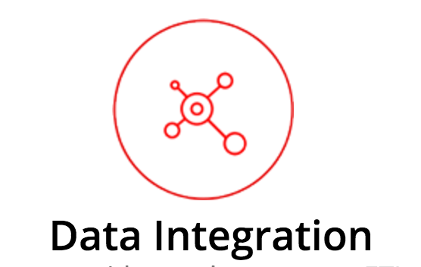
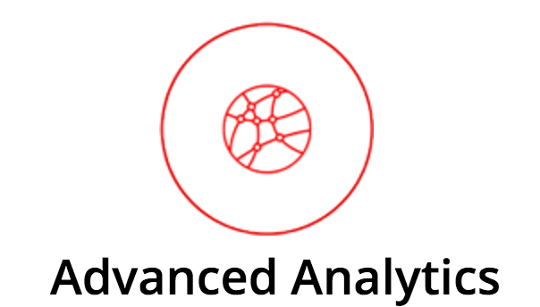
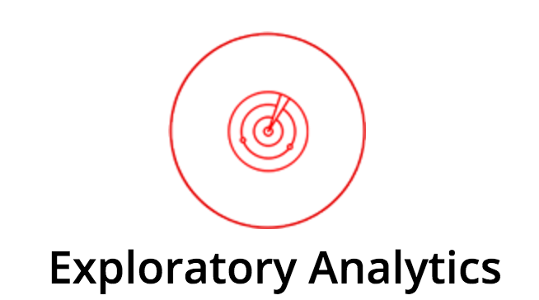
About Sigmoid
We build reactive real-time big data systems.

Slide 3
1 | Data Management
2 | Cassandra Introduction
3 | Apache Spark Streaming
4 | Reactive Data Pipelines
5 | Use cases

Slide 4
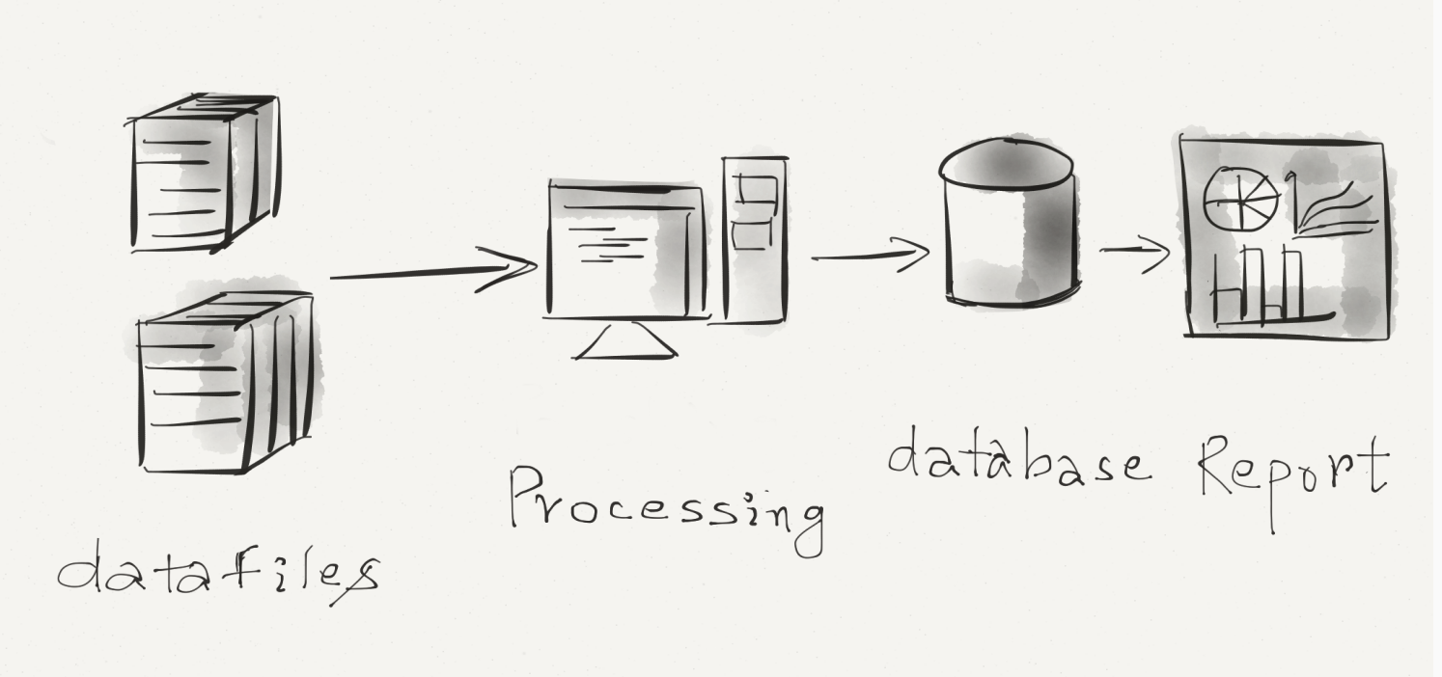
Data Management
Managing data and analyzing data have always greatest benefit and the greatest challenges for organization.

Slide 5
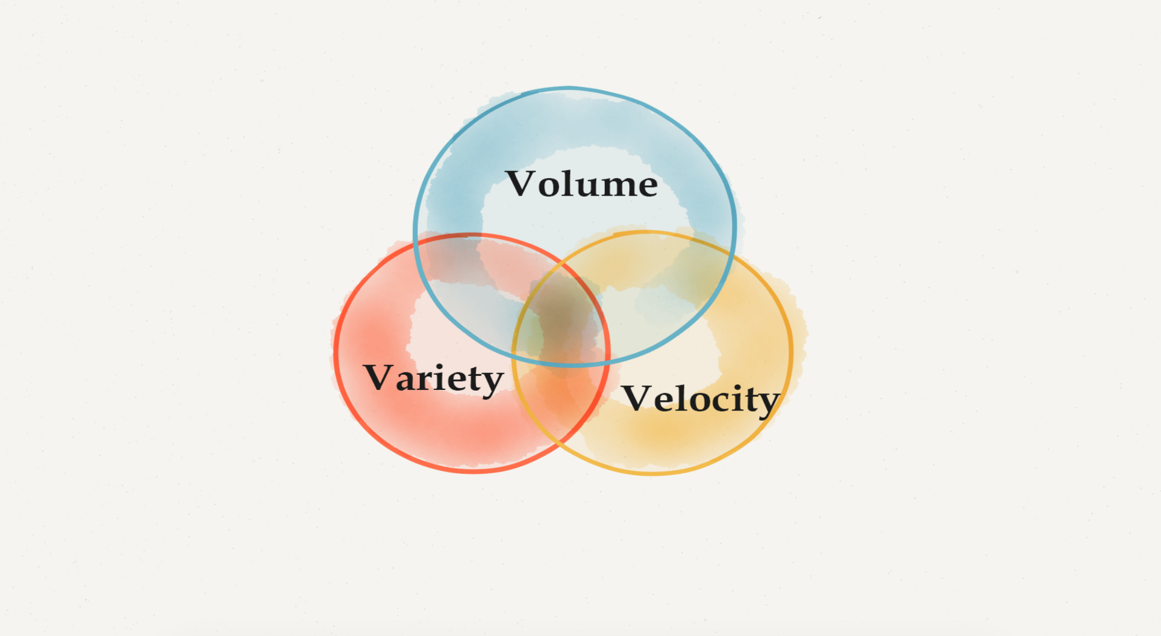
Three V’s of Big data
Notes:
Volume : Terabytes, Records, Transactions, Tables, files
Velocity : Batch, Near real time, realtime
Variety : Structured, unstructured, semi structured

Slide 6
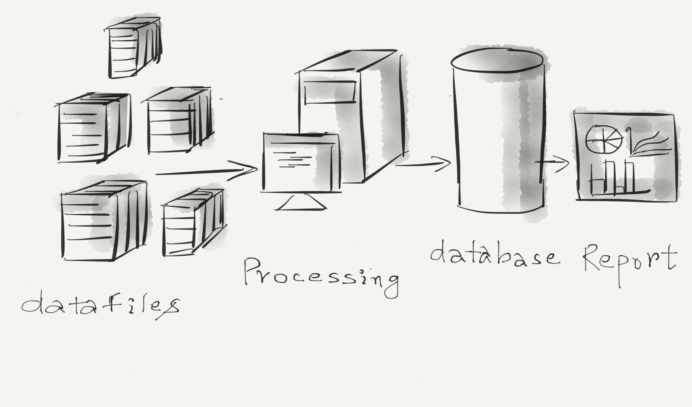
Scale Vertically
Notes:
Vertical scaling means that you scale by adding more power (CPU, RAM) to an existing machine.
In vertical-scaling the data resides on a single node and scaling is done through multi-core i.e. spreading the load between the CPU and RAM resources of that machine.

Slide 7
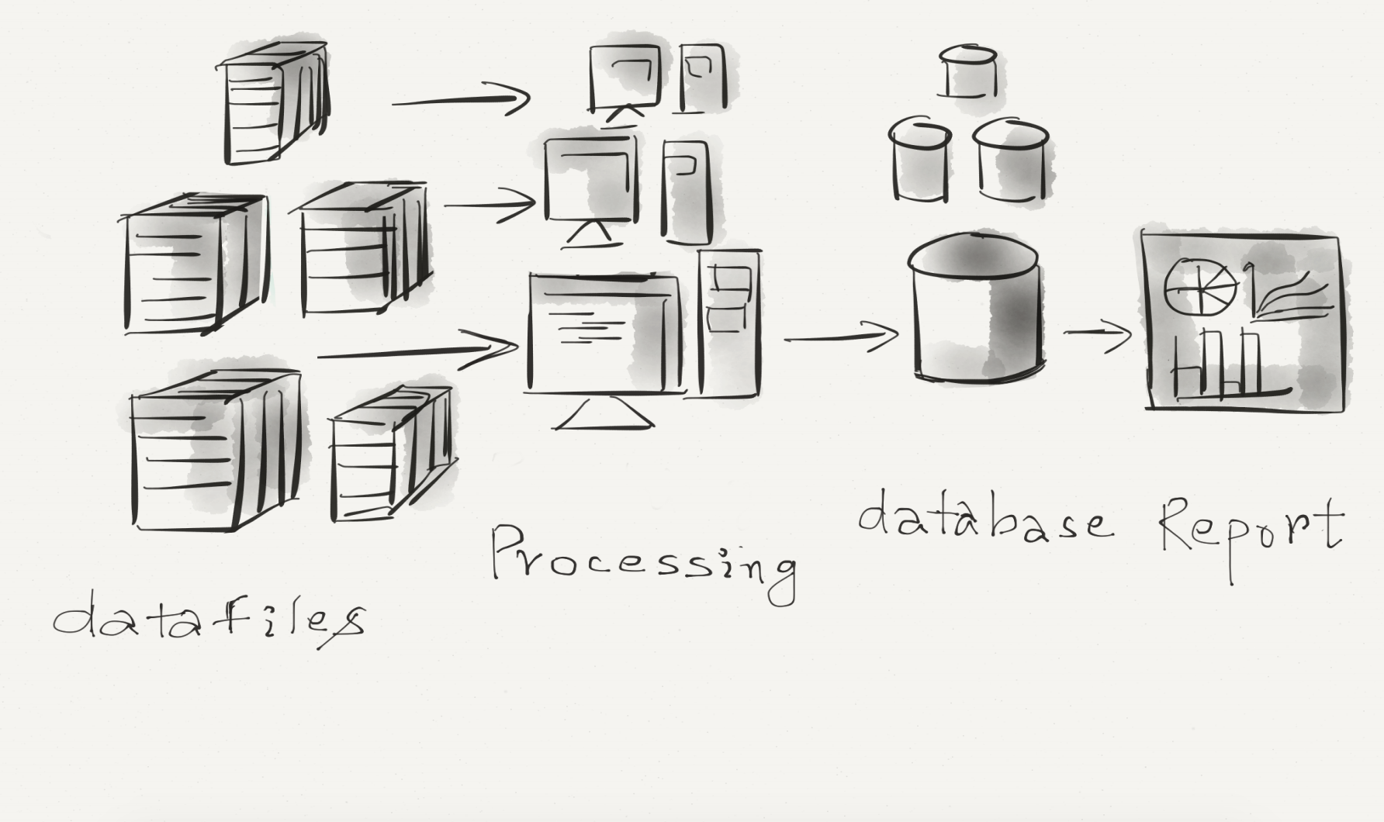
Scale Horizontally
Notes:
Horizontal scaling means that you scale by adding more machines into your pool of resources.
In a database horizontal-scaling is often based on partitioning of the data
i.e. each node contains only part of the data.
With horizontal-scaling it is often easier to scale dynamically by adding more machines into the existing pool.
If a cluster requires more resources to improve performance and provide high availability (HA), an administrator can scale out by adding more machine to the cluster.

Slide 8
Understanding Distributed Application
“ A distributed system is a software system in which components located on networked computers communicate and coordinate their actions by passing messages.”

Slide 9
Principles Of Distributed Application Design
Availability
Performance
Reliability
Scalability
Manageability
Cost
Notes:
Scalability : Hyper scale, load balancing, scale out.
Availability : Failure resilient, rolling updates, recovery from failures.
Manageability : Granular versioning, micro service

Slide 10
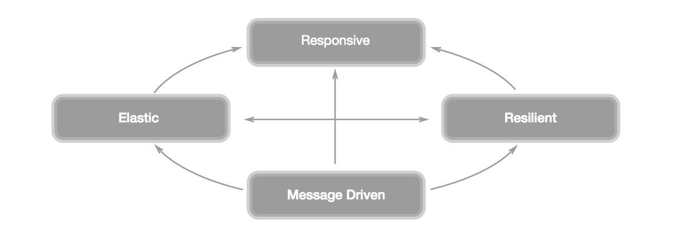
Reactive Application
Notes:
Responsive: The system responds in a timely manner if at all possible.
Resilient: The system stays responsive in the face of failure. This applies not only to highly-available, mission critical systems — any system that is not resilient will be unresponsive after a failure.
Elastic: The system stays responsive under varying workload. Reactive Systems can react to changes in the input rate by increasing or decreasing the resources allocated to service these inputs.
Message Driven: Reactive Systems rely on asynchronous message-passing to establish a boundary between components that ensures loose coupling, isolation and location transparency.

Slide 11








Reactive libraries, tools and frameworks

Slide 12
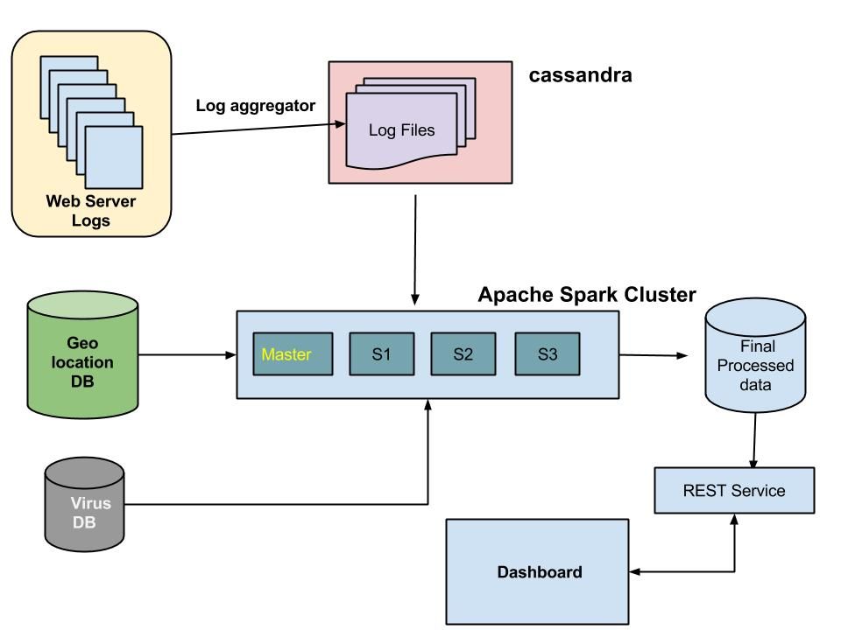


Notes:
Micro service:
33TB Monthly → 1.1 TB daily

Slide 13
Cassandra Introduction
Cassandra - is an Open Source, distributed store for structured data that scale-out on cheap, commodity hardware.
Born at Facebook, built on Amazon’s Dynamo and Google’s BigTable
Notes:
The distributed storage system Cassandra, for example, runs on top of hundreds of commodity nodes spread across different data centers. Because the commodity hardware is scaled out horizontally, Cassandra is fault tolerant and does not have a single point of failure (SPoF).

Slide 14
Why Cassandra

Slide 15
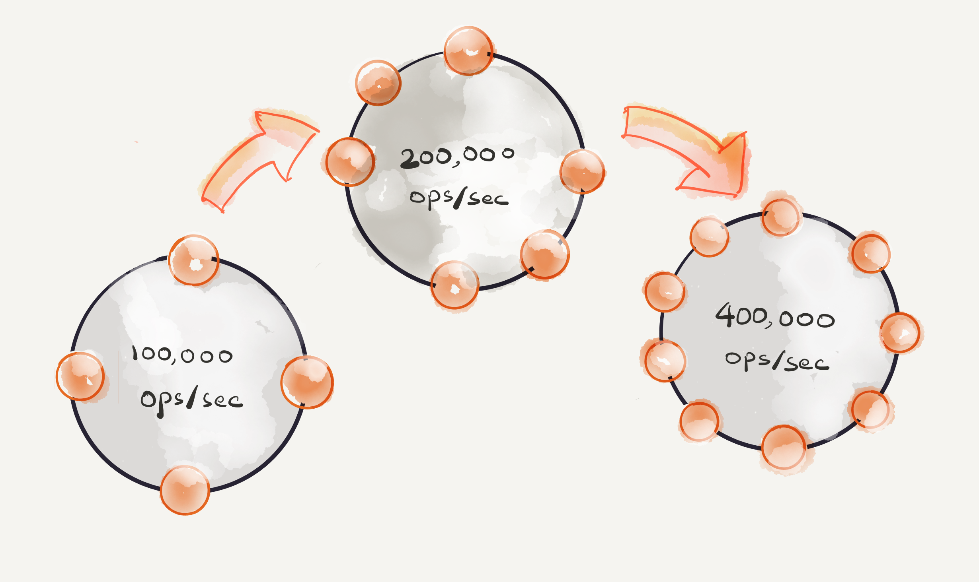
Highly scalable NoSQL database
Cassandra supplies linear scalability
Cassandra is a partitioned row store database
Automatic data distribution
Built-in and customizable replication

Slide 16
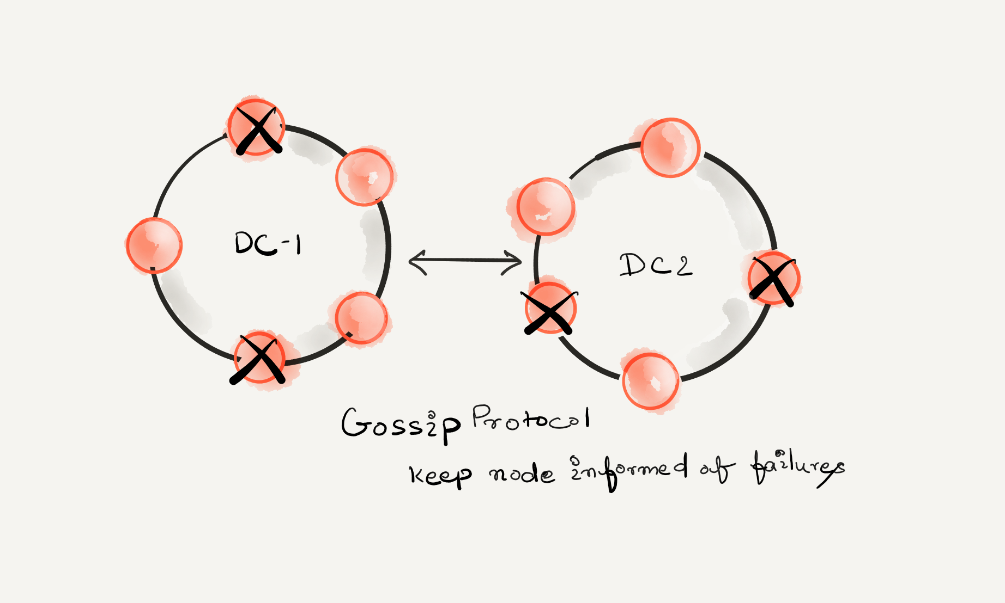
High Availability
In a Cassandra cluster all nodes are equal.
There are no masters or coordinators at the cluster level.
Gossip protocol allows nodes to be aware of each other.

Slide 17
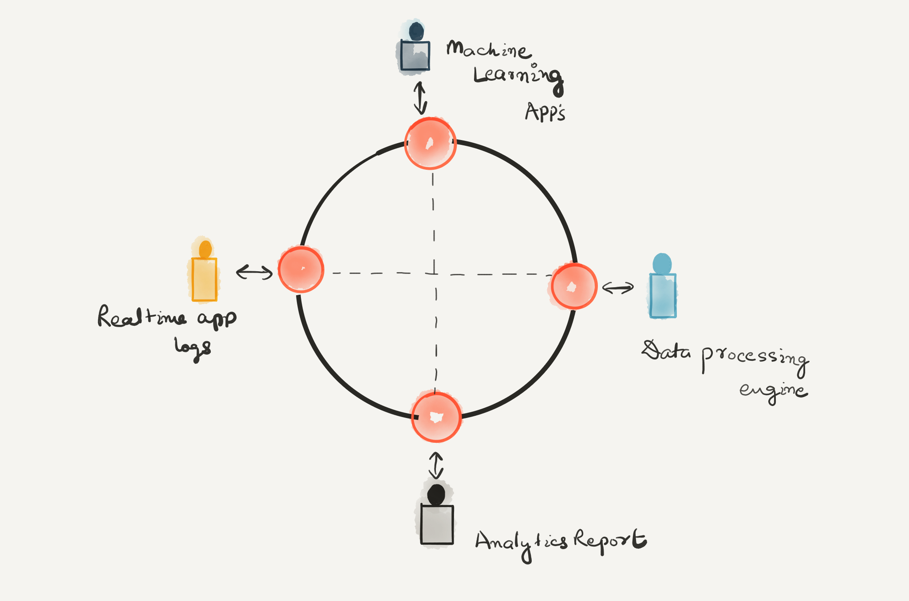
Read/Write any where
Cassandra is a R/W anywhere architecture, so any user/app can connect to any node in any DC and read/write the data.

Slide 18
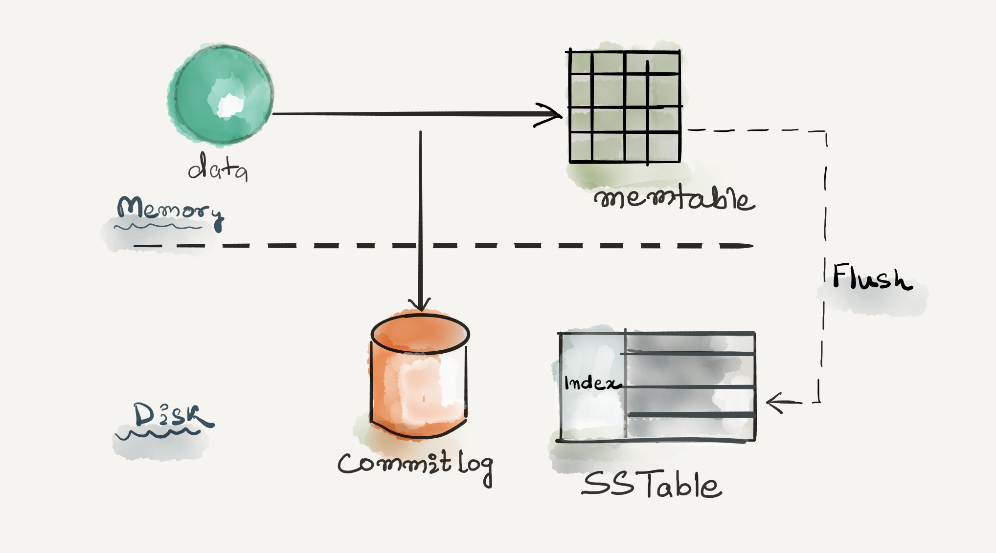
High Performance
All disk writes are sequential, append-only operations.
Ensure No reading before write.

Slide 19
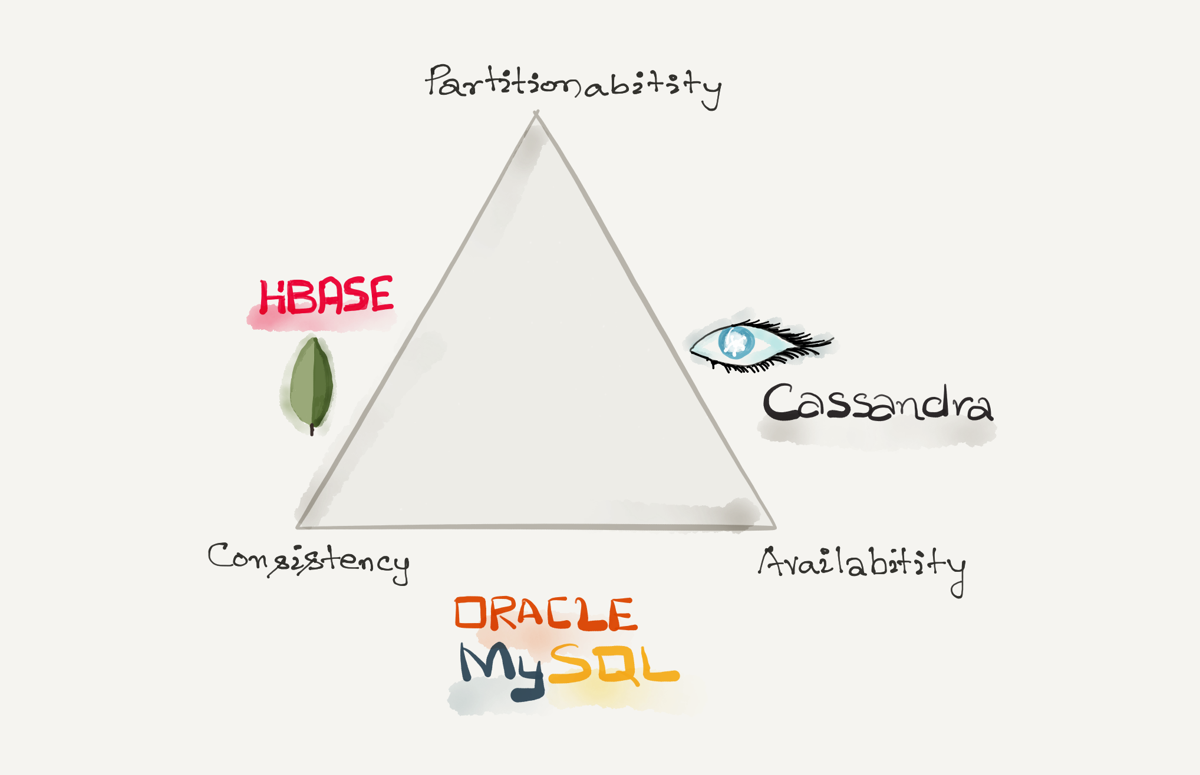
Cassandra & CAP
Cassandra is classified as an AP system
System is still available under partition
Notes:
Cassandra supports a per-operation tradeoff between consistency and availability through Consistency Levels.
The following consistency levels are available:
ONE : Only a single replica must respond.
TWO :Two replicas must respond.
THREE : Three replicas must respond.
QUORUMA : majority (n/2 + 1) of the replicas must respond.
ALL :All of the replicas must respond.
LOCAL_QUORUMA :majority of the replicas in the local datacenter (whichever datacenter the coordinator is in) must respond.
EACH_QUORUMA : majority of the replicas in each datacenter must respond.
LOCAL_ONE : Only a single replica must respond. In a multi-datacenter cluster, this also gaurantees that read requests are not sent to replicas in a remote datacenter.
ANY : A single replica may respond, or the coordinator may store a hint. If a hint is stored, the coordinator will later attempt to replay the hint and deliver the mutation to the replicas. This consistency level is only accepted for write operations.

Slide 20
CQL
CREATE KEYSPACE MyAppSpace WITH
REPLICATION = { 'class' : 'SimpleStrategy', 'replication_factor' : 3 };
USE MyAppSpace ;
CREATE COLUMNFAMILY AccessLog(id text, ts timestamp ,ip text, port text, status text, PRIMARY KEY(id));
INSERT INTO AccessLog (id, ts, ip, port, status) VALUES (’id-001-1', 2016-01-01 00:00:00+0200', ’10.20.30.1’,’200’);
SELECT * FROM AccessLog ;

Slide 21
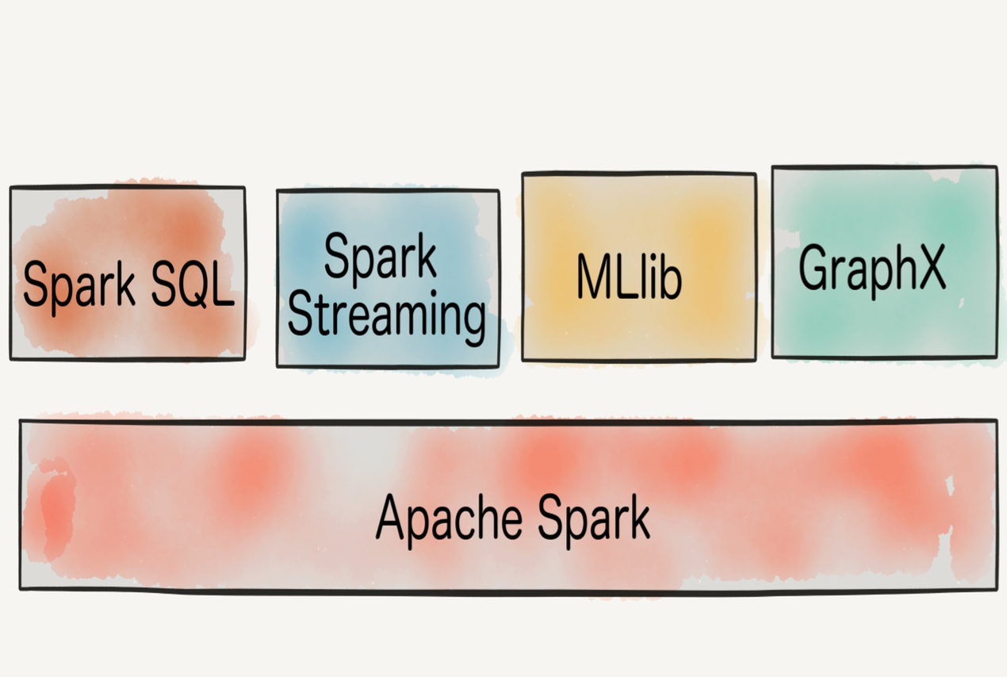
Apache Spark
Introduction
Apache Spark is a fast and general execution engine for large-scale data processing.
Organize computation as concurrent tasks
Handle fault-tolerance, load balancing
Developed on Actor Model

Slide 22
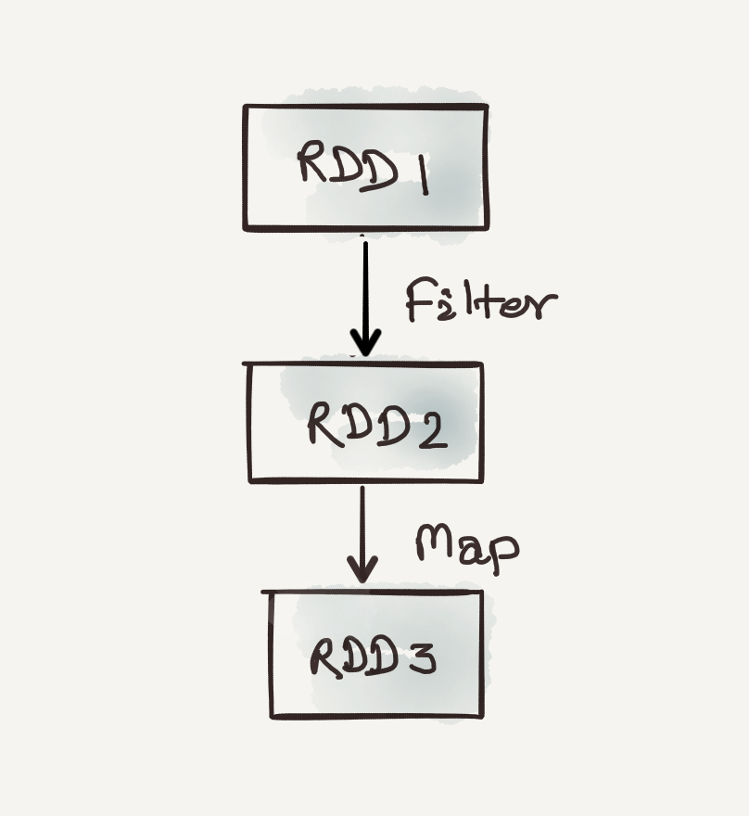
RDD Introduction
Resilient Distributed Datasets (RDDs), a distributed memory abstraction that lets programmers perform in-memory computations on large clusters in a fault-tolerant manner.
RDD shared the data over a cluster, like a virtualized, distributed collection.
Users create RDDs in two ways: by loading an external dataset, or by distributing a collection of objects such as List, Map etc.
Notes:
Spark and Spark Streaming with the RDD concept at the core are inherently designed to recover from worker failures.

Slide 23
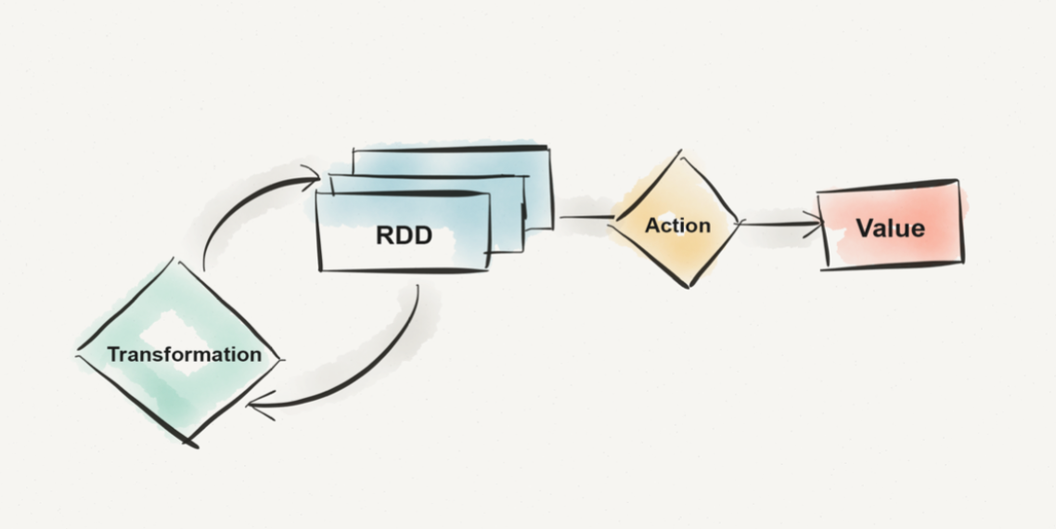
RDD Operations
Two Kind of Operations
Transformation
Action

Slide 24
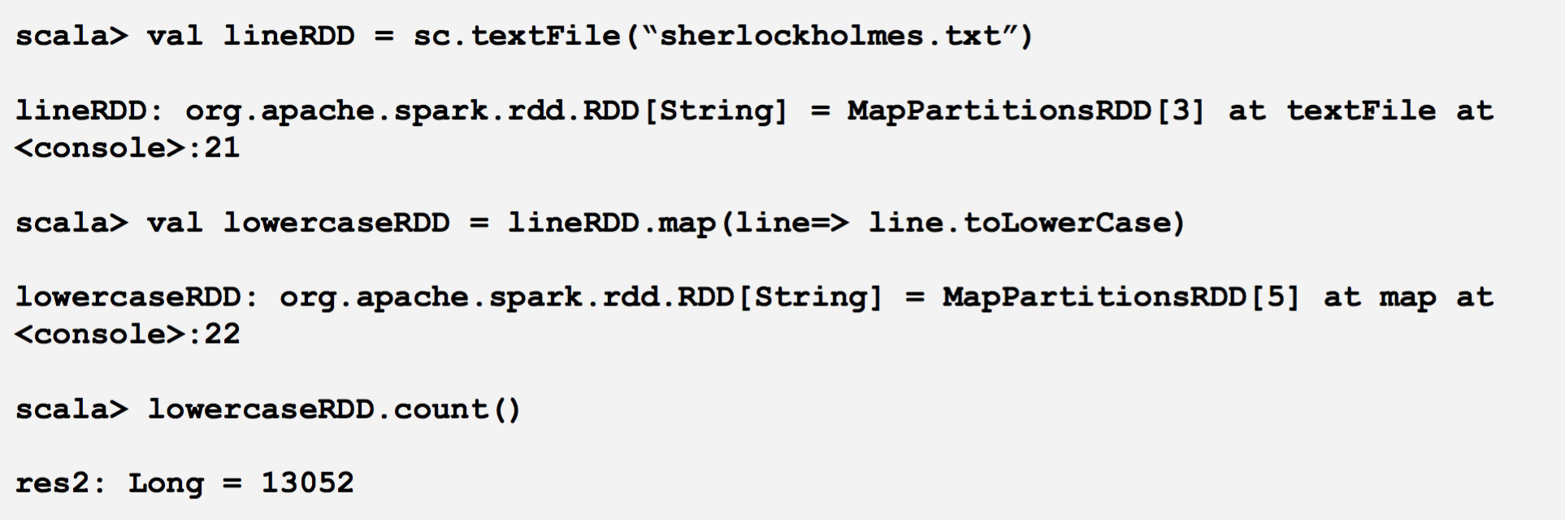

Slide 25
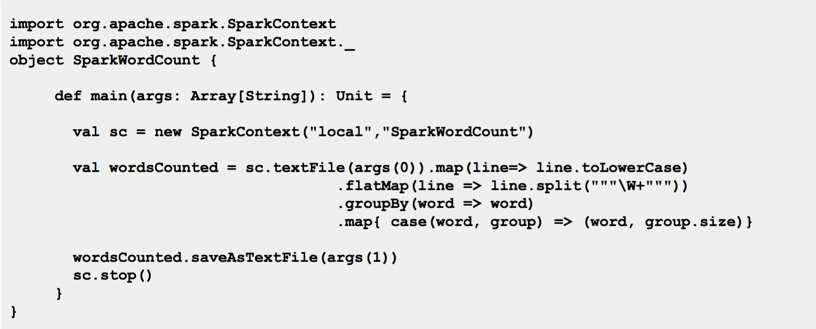

Slide 26
What is Spark Streaming?
Framework for large scale stream processing
Created at UC Berkeley
Scales to 100s of nodes
Can achieve second scale latencies
Provides a simple batch-like API for implementing complex algorithm
Can absorb live data streams from Kafka, Flume, ZeroMQ, Kinesis etc.

Slide 27
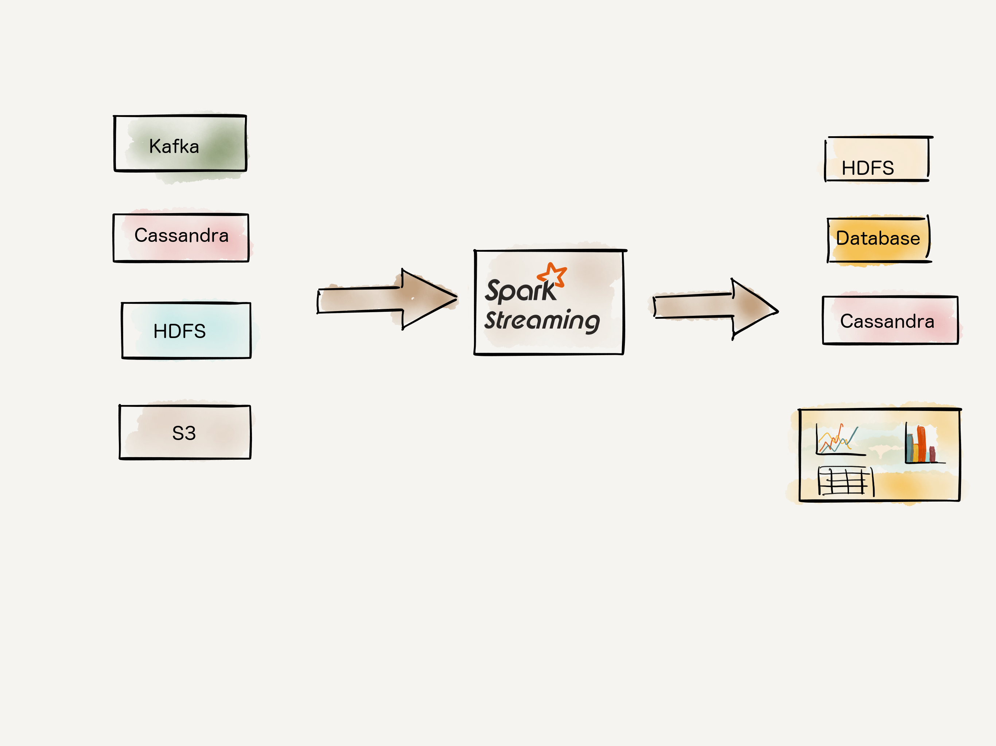
Spark Streaming
Introduction
Spark Streaming is an extension of the core spark API that enables scalable, high-throughput, fault-tolerant stream processing of live data streams.
Notes:
Stateful exactly-once semantics out of the box.
Spark Streaming recovers both lost work and operator state (e.g. sliding windows) out of the box, without any extra code on your part.

Slide 28
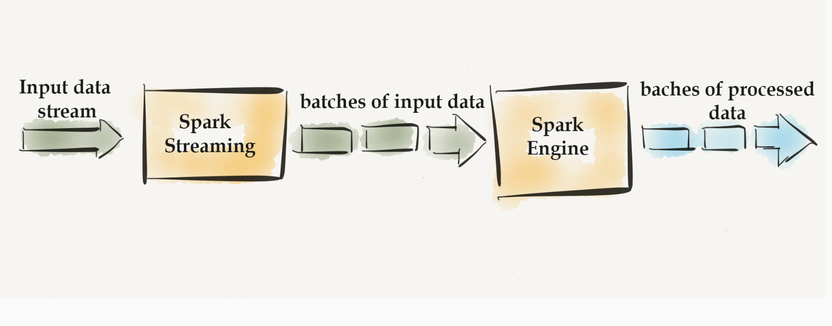

Slide 29



Slide 31
Spark Streaming over a HA Mesos Cluster
To use Mesos from Spark, you need a Spark binary package available in a place
accessible (http/s3/hdfs) by Mesos, and a Spark driver program configured to
connect to Mesos.
Configuring the driver program to connect to Mesos:
val sconf = new SparkConf()
.setMaster("mesos://zk://10.121.93.241:2181,10.181.2.12:2181,10.107.48.112:2181/mesos")
.setAppName(”HAStreamingApp")
.set("spark.executor.uri","hdfs://Sigmoid/executors/spark-1.6.0-bin-hadoop2.6.tgz")
.set("spark.mesos.coarse", "true")
.set("spark.cores.max", "30")
.set("spark.executor.memory", "10g")
val sc = new SparkContext(sconf)
val ssc = new StreamingContext(sc, Seconds(1))

Slide 32
Spark Cassandra Connector
It allows us to expose Cassandra tables as Spark RDDs
Write Spark RDDs to Cassandra tables
Execute arbitrary CQL queries in your Spark applications.
Compatible with Apache Spark 1.0 through 2.0
It Maps table rows to CassandraRow objects or tuples
Do Join with a subset of Cassandra data
Partition RDDs according to Cassandra replication

Slide 33
build.sbt should include:
resolvers += "Spark Packages Repo" at "https://dl.bintray.com/spark-packages/maven"
libraryDependencies += "datastax" % "spark-cassandra-connector" % "1.6.0-s_2.10"
import com.datastax.spark.connector._

Slide 34
Get a Spark RDD that represents a Cassandra table
val rdd = sc.cassandraTable(“applog”, “accessTable”)
println(rdd.count)
println(rdd.first)
println(rdd.map(_.getInt("value")).sum)
Save Data Back to Cassandra
collection.saveToCassandra(“applog”, "accessTable", SomeColumns(”city", ”count"))
Notes:
sc.cassandraTable("keyspace name", "table name")

Slide 35
Many more higher order functions:
repartitionByCassandraReplica : It be used to relocate data in an RDD to match
the replication strategy of a given table and keyspace
joinWithCassandraTable : The connector supports using any RDD as a source of
a direct join with a Cassandra Table

Slide 36
Hint to scalable pipeline
Figure out the bottleneck : CPU, Memory, IO, Network
If parsing is involved, use the one which gives high performance.
Proper Data modeling
Compression, Serialization

Slide 37
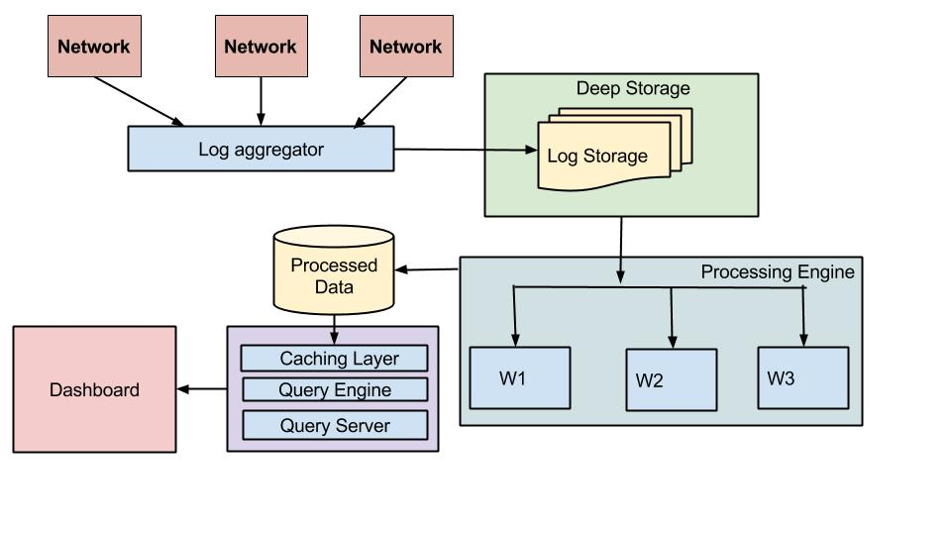

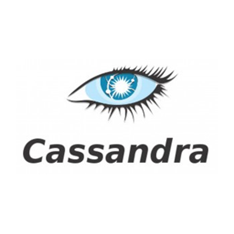

Slide 38
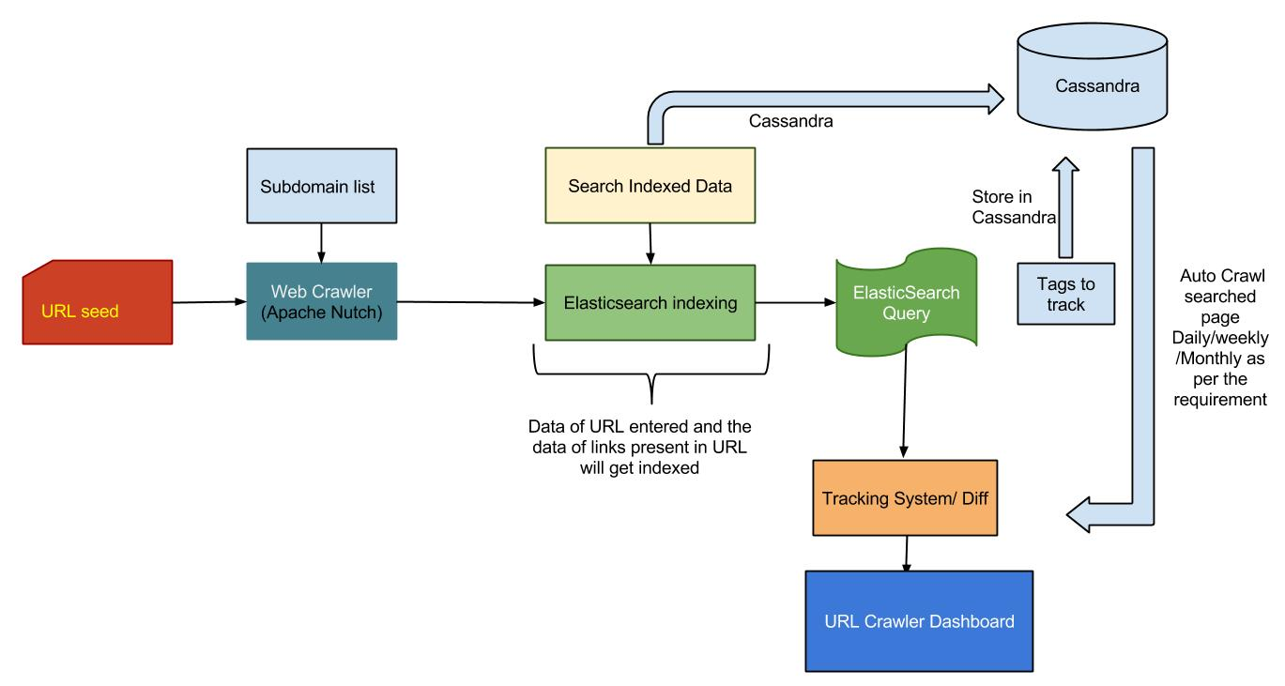

Slide 39
Thank You
@rahul_kumar_aws

